Slide 1
HDDS1104 Operating Systems and Networking
Topic 05 Introduction to Computer Networking

Slide 2
Intended Learning Outcomes
Describe services provided in a computer network
Discuss different network topologies and technologies
Describe the OSI reference model
List relevant protocols involved in TCP/IP model
Explain network security and protection issues

Slide 3
What is computer network?

Slide 4
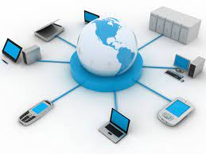
What is computer network?
a group of computers that
use a set of common communication protocols over digital interconnections
for the purpose of sharing resources located on or provided by the network nodes.
Including
personal computers, servers, networking hardware, or other specialized or general-purpose hosts.
identified by hostnames and network addresses.

Slide 5
Services of Computer Networks
Helps you to share resource such as printers
Allows you to share expensive software's and database among network participants
Provides fast and effective communication from one computer to another computer
Helps you to exchange data and information among users via a network

Slide 6
Function of computer network
Shared data - Shared data are data that file servers provide to clients such as data files, printer access programs and e-mail.
Shared printers and other peripherals - Shared printers and peripherals are hardware resources provided to the users of the network by servers.

Slide 7
Network devices

Slide 8
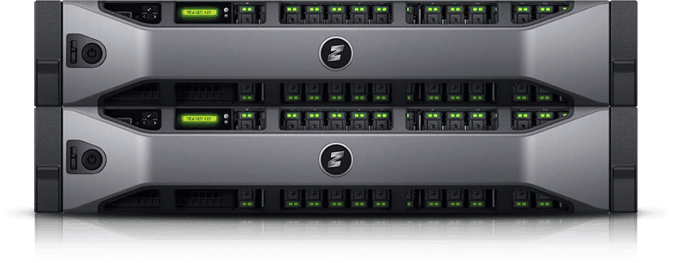
Servers
computers that hold shared files, programs, and the network operating system.
provide access to network resources to all the users of the network.
Examples
File servers, print servers, mail servers, communication servers, database servers, fax servers and web servers

Slide 9
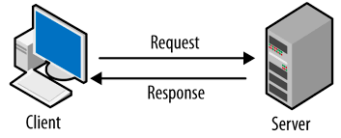
Clients
Clients are computers that access and use the network and shared network resources.
Traditional model
Client/Server
Client request service,
Server respond with resource
Peer-to-peer
Peer nodes serve as both clients & servers to other nodes.

Slide 10
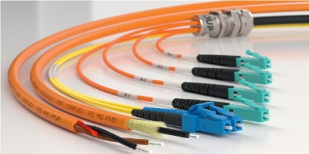
Transmission Media
facilities used to interconnect computers in a network,
such as
twisted-pair wire,
coaxial cable, and
optical fiber cable.

Slide 11
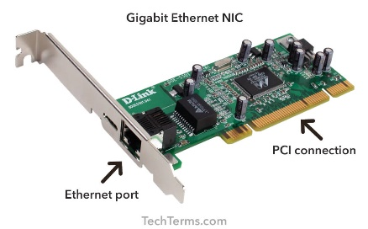
Network Interface Card (NIC)
a special expansion card / port in each computer
Functions
prepares (formats) and sends data,
receives data, and
controls data flow between the computer and the network.

Slide 12
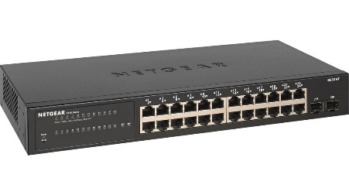
Hub
a device that splits a network connection into multiple computers.
Each computer in the network should then figure out whether the broadcast data is for them or not.

Slide 13
Switch
a telecommunication device grouped as one of computer network components.
Switch is like a Hub but built in with advanced features.
It uses physical device addresses in each incoming messages so that it can deliver the message to the right destination or port.

Slide 14
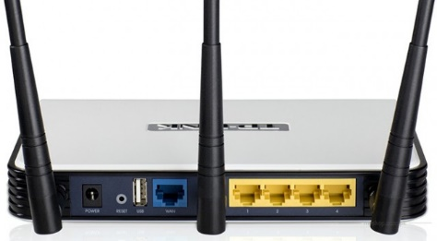
Router
device that used to connect a LAN with an internet connection
have two distinct networks (LANs) or want to share a single internet connection to multiple computers, we use a Router.
Types of Router:
wired
wireless.
choice depends on physical setting, speed and cost.

Slide 15
Cisco Packet Tracer
a tool that allows you to simulate real networks. It provides three main menus that allow you to:
add devices and connect them via cables or wireless
select, delete, inspect, label, and group components within your network
manage your network
may sign up and download version 8.2.0 or latest version in the following URL:
https://www.netacad.com/about-networking-academy/packet-tracer/

Slide 16
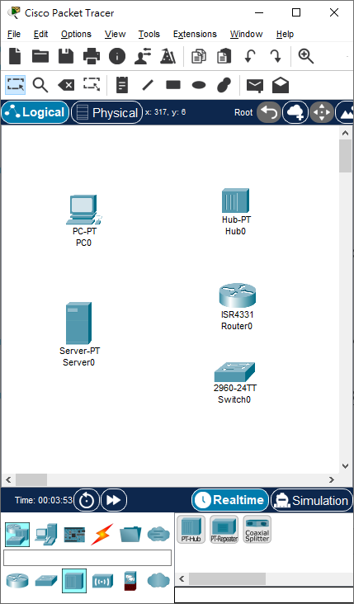
Exercise – Launching Cisco Packet Tracer
Start Cisco Packet Tracer
Add the following devices
End Devices:
PC, Server
Network Devices:
Router, Switch, Hub

Slide 17
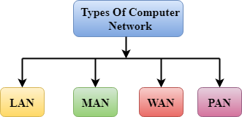
Categories of networks

Slide 18
Categories of networks
can be categorized by their size.
A computer network is mainly of four types:
PAN(Personal Area Network)
LAN(Local Area Network)
MAN(Metropolitan Area Network)
WAN(Wide Area Network)

Slide 19
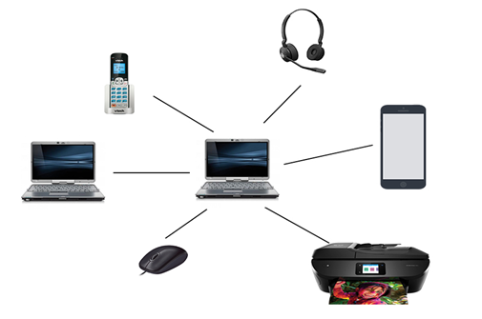
PAN (Personal Area Network)
used for connecting the computer devices of personal use
Personal computer devices that are used
laptop, mobile phones, media player and play stations.
Types of Personal Area Network
Wired Personal Area Network: created by using the USB
Wireless Personal Area Network: such as WiFi, Bluetooth

Slide 20
LAN (Local Area Network)
a group of computers connected to each other in a small area such as building, office.
used for connecting two or more personal computers through a communication medium such as twisted pair, coaxial cable, etc.
less costly as it is built with inexpensive hardware
such as hubs, network adapters, and Ethernet cables.
Example:
Home Wi-Fi networks and
small business networks

Slide 21
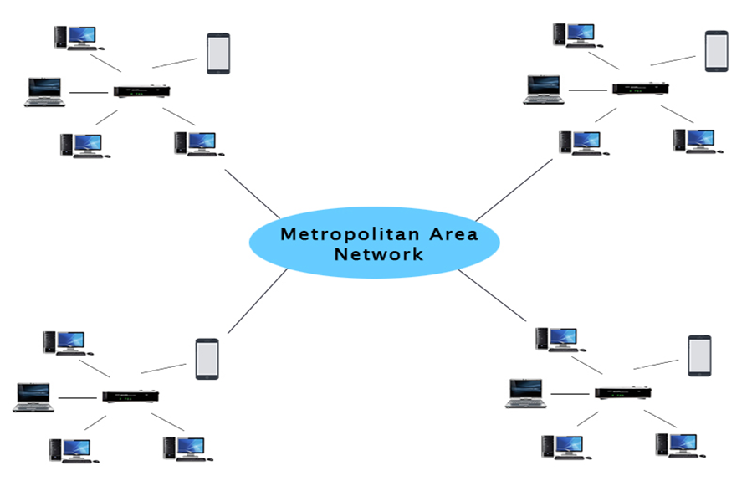
MAN (Metropolitan Area Network)
Covers a larger geographic area
by interconnecting a different LAN to form a larger network.
Government agencies use MAN to connect to the citizens and private industries.
It has a higher range than Local Area Network (LAN).

Slide 22
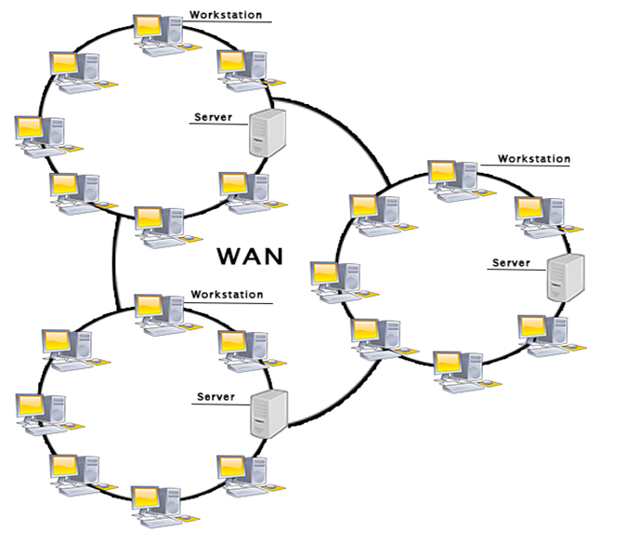
WAN (Wide Area Network)
Extends over a large geographical area such as states or countries.
biggest WAN in the world
The internet
widely used in the field of Business, government, and education.

Slide 23
Examples of Wide Area Network:
Mobile Broadband:
A 4G network is widely used across a region or country.
Last mile:
A telecom company is used to provide the internet services to the customers in hundreds of cities by connecting their home with fiber

Slide 24
Network topologies

Slide 25
Physical network topologies
Network topologies describe the methods in which all the elements of a network are mapped.
Examples
Point to point topology
Point to multipoint topology
Bus Topology
Ring Topology
Star Topology
Mesh Topology
Hybrid Topology

Slide 26
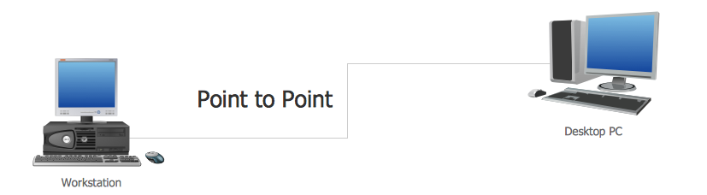
Point to point topology
point to point topology connects any two points (devices) in a network.

Slide 27
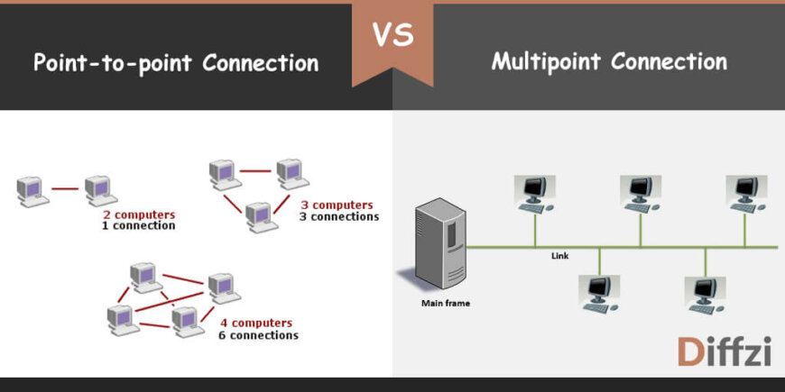
Point to multipoint topology
connects one to many points.
provides multiple paths from a single device to multiple devices.

Slide 28
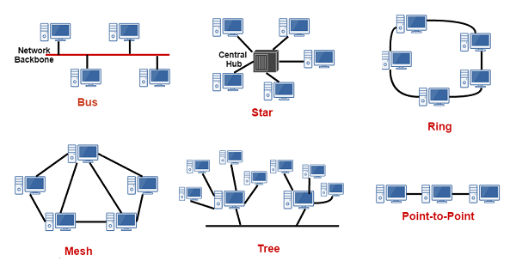
Bus Topology
uses a single cable which connects all the included nodes.
The main cable acts as a spine for the entire network.
One of the computers in the network acts as the computer server.

Slide 29
Ring Topology
every device has exactly two neighboring devices for communication purpose.
its formation is like a ring.
every computer is connected to another computer.
the last node is combined with a first one.

Slide 30
Star Topology
All the computers connect with the help of a hub.
This hub is called a central node,
all other nodes are connected using this central node.

Slide 31
Mesh Topology
It develops a P2P (point-to-point) connection between all the devices of the network.
It offers a high level of redundancy, so even if one network cable fails, still data has an alternative path to reach its destination.

Slide 32
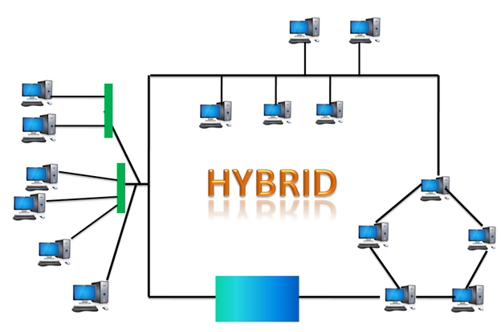
Hybrid Topology
Hybrid topology combines two or more topologies.

Slide 33
How to select a Network Topology?
Here are some important considerations for selecting the best topology to create a network in your organization:
Bus topology is surely least expensive to install a network.
If you want to use a shorter cable or planning to expand the network in future, then star topology is the best choice for you.
Fully mesh topology is theoretically an ideal choice as every device is connected to every other device.
If you want to use twisted pair cable for networking, then you should build star topologies.

Slide 34
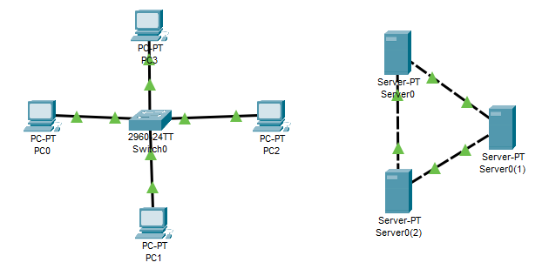
Exercise – Star Network & Ring Network
Use Cisco packet tracer to build a start & a ring network
Only server support 2 NICs

Slide 35
Signalling and Encoding

Slide 36
Transmission Modes
the mechanism of transferring of data between two devices connected over a network.
also called Communication Mode.
Types of transmission modes
Simplex Mode
Half duplex Mode
Full duplex Mode

Slide 37
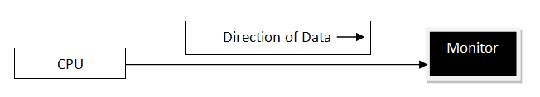
SIMPLEX Mode
data can be sent only in one direction.
Examples
loudspeakers,
television broadcasting,
television and remote,
keyboard and monitor etc.

Slide 38
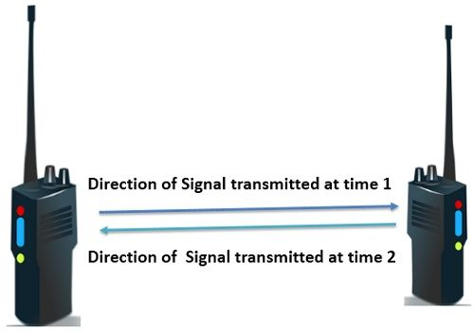
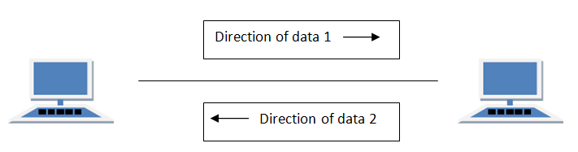
HALF DUPLEX Mode
data can be transmitted in both directions on a signal carrier, but not at the same time.
Example of half duplex is a walkie- talkie in which message is sent one at a time but messages are sent in both the directions.

Slide 39

FULL DUPLEX Mode
We can send data in both the directions as it is bidirectional at the same time in other words, data can be sent in both directions simultaneously.
Example of Full Duplex is a Telephone Network in which there is communication between two persons by a telephone line, using which both can talk and listen at the same time.

Slide 40
Signaling and Encoding
Signaling is the method by which you define what a one or zero is.
Encoding is how you use the 1s and 0s to represent information.
Decoding is the reverse process of encoding which is to extract the information from the converted format.

Slide 41
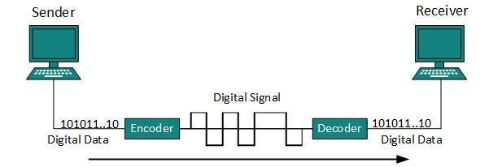
Transmission of digital data
Data transmission (data communications) is the transfer and reception of data (a digital bit-stream or a digitized analog signal) over a point-to-point or point-to-multipoint communication channel.

Slide 42
Open Systems Interconnection (OSI) Model

Slide 43
Computer Network Models: Layered Architecture
main aim
to divide the design into small pieces.
Each lower layer adds its services to the higher layer
to provide a full set of services to manage communications and run the applications.
ensures the independence between layers
by providing the services from lower to higher layer
without defining how the services are implemented.
any modification in a layer will not affect the other layers.

Slide 44
Open Systems Interconnection (OSI) Model
Reference conceptual model
Communications split in 7 abstraction layers
1. Physical
2. Data Link
3. Network
4. Transport
5. Session
6. Presentation
7. Application

Slide 45
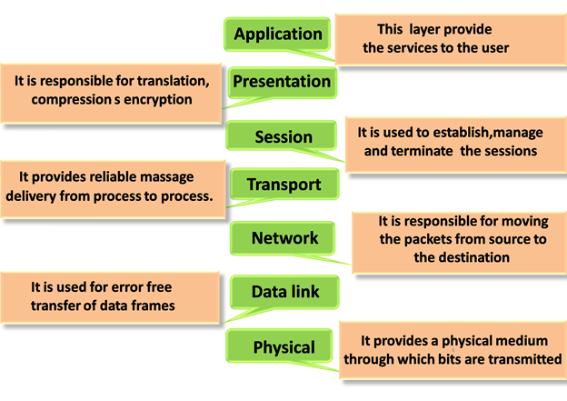
OSI Model

Slide 46
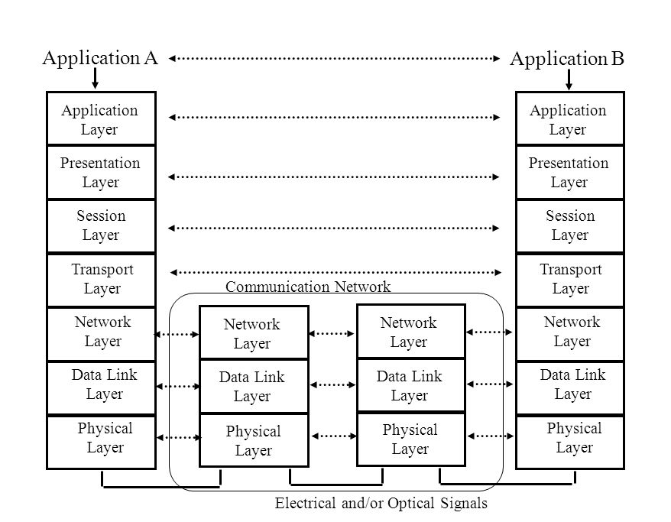
Functions of layers

Slide 47
Transmission Control Protocol/Internet Protocol (TCP/IP) model

Slide 48
Internet protocol suite (TCP/IP)
Set of communication protocols used on the Internet & similar computer networks
Current foundational protocol
Transmission Control Protocol (TCP)
Internet Protocol (IP)
User Datagram Protocol (UDP)

Slide 49
Internet Protocol Data Flow
Application Layer
Application Layer
Transport Layer
Transport Layer
Network Layer
Network Layer
Network Layer
Network Layer
Data-Link Layer
Data-Link Layer
Internet
Data-Link Layer
Data-Link Layer

Slide 50
Protocols involved
Application layer
HTTP, HTTPS, FTP, SMTP, POP3
Transport layer
TCP, UDP
Network layer
IPv4, IPv6
Data-link layer
PPP
ARP, RARP,
Wi-Fi, Ethernet
Notes:
HTTP Hypertext Transfer Protocol
Simple Mail Transfer Protocol
Post Office Protocol
UDP: User Datagram protocol
PPP
Point-to-Point Protocol
ARP
Address Resolution Protocol
Reverse Address Resolution Protocol

Slide 51
Transmission Control Protocol
Provides reliable, ordered, and error-checked delivery of a stream of bytes
between applications running on hosts communicating via an IP network
Connection-oriented
Typical ports for applications
WWW - 80
Email - 25
FTP - 21

Slide 52
Internet Protocol
Network layer communication protocol
Relaying datagram across network boundaries
Delivering packets
From source host
To the destination host
Using IP Address

Slide 53
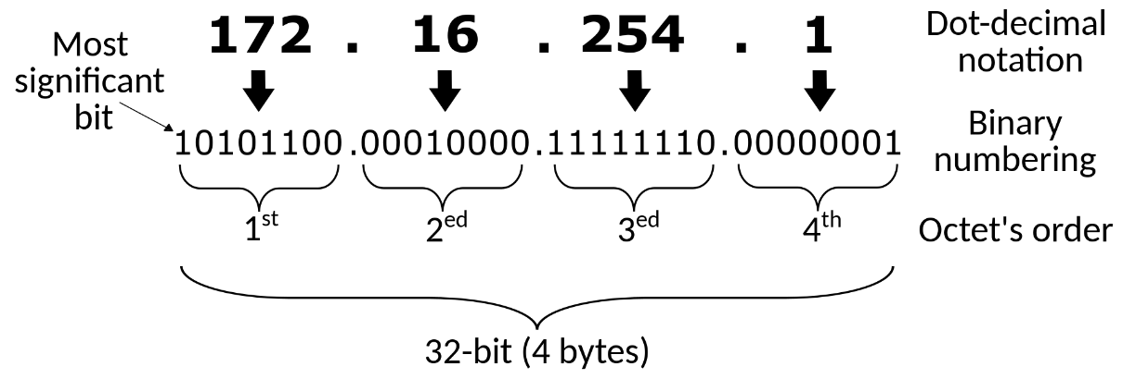
IP Address
A numeric label used for network interface identification and location addressing
Each network interface has a unique IP address inside a network
IPv4
A 32-bit number
E.g.: 192.0.2.1
IPv6
128-bit number
E.g.: 2001:db8:0:1234:0:567:8:1

Slide 54
Domain Name System (DNS)
Hierarchical & decentralized naming system
used to identify computers reachable through the Internet
Commonly used to
Map human-friendly domain names
To the numerical IP address
Example
www.gmail.com (DNS) -> 142.251.220.69 (IP)

Slide 55
Data-link layer
Lowest layer in the TCP/IP suite
Link
Physical & logical network components used to interconnect hosts / nodes in the network
Link protocol
Methods & standards that operate only between adjacent network nodes of a network segment
Example
Ethernet, Wi-Fi, PPP

Slide 56
Exercise – Checking Windows Network Setting
Check the [Network Connections] inside windows 10/11.
Check the version of TCP/IP in use
Check the IP of your computer

Slide 57
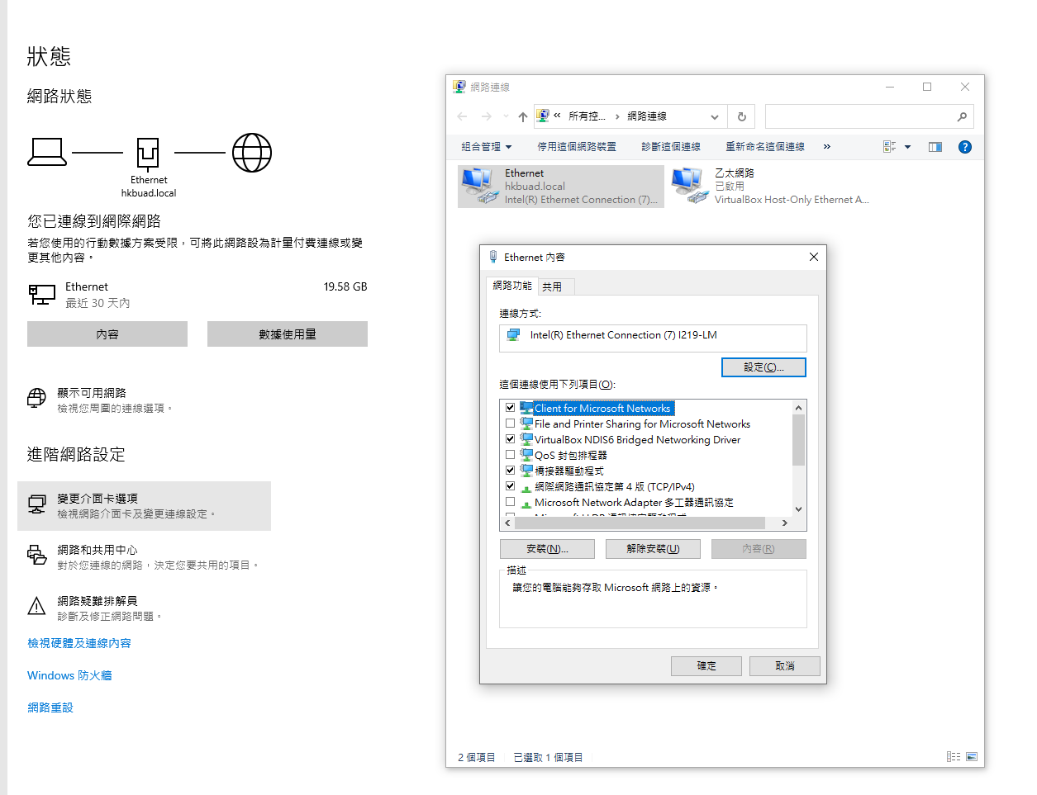
Checking network status – Windows 10
May need Administrative right
Do it at home
Control Panel
Network & Internet
Status
Change Network Adapter

Slide 58
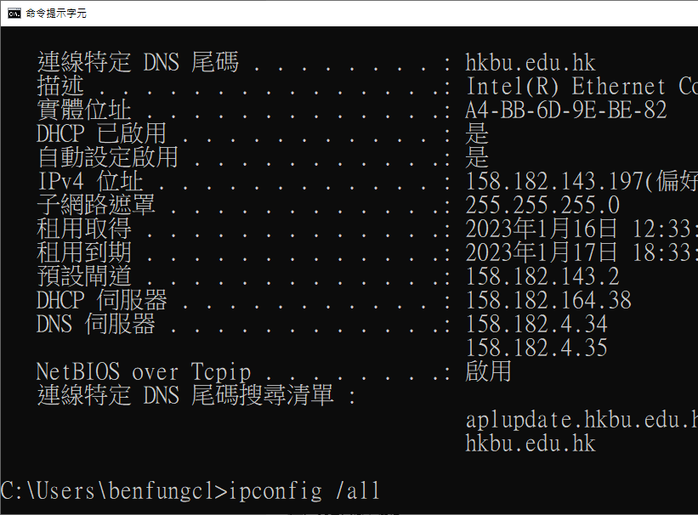
Checking network status -
Search for ‘cmd’
cmd: Command Prompt of windows
Type ‘ipconfig /all’
Show all network setting

Slide 59
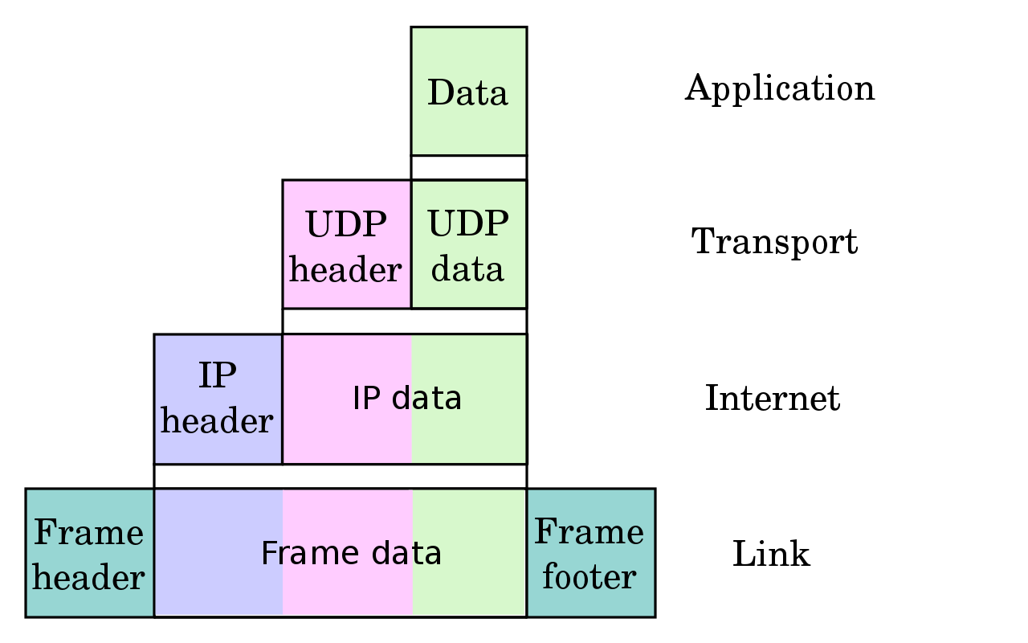
Encapsulation of application data
Source: https://en.wikipedia.org/wiki/Internet_Protocol#/media/File:UDP_encapsulation.svg

Slide 60
Network threats

Slide 61
Network security: Security threat
Denial of Service (DoS) attack
Distributed DoS attack
Man in the middle
Social engineering
Virus
Worms
Phishing

Slide 62
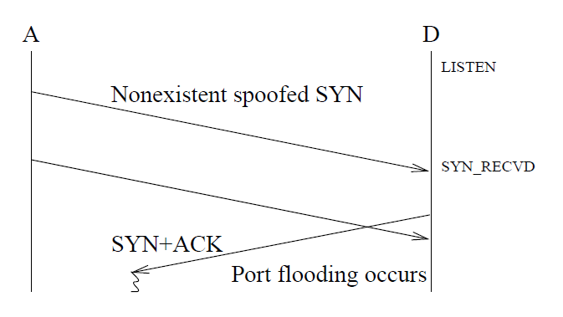
Denial of Service (DoS) attack
overwhelms the network host with the stream of bogus data which keep it to process the designed data.
Image source: (Schuba et al, 1997) Analysis of a Denial of Service Attack on TCP

Slide 63
Distributed DoS attack
attacking an online service or a website by the huge amount of traffic coming from various sources and thus leading to the interruption of the services or even shutting down the network

Slide 64
Man in the middle
occurs when the person keep a logical connection or equipment between 2 communicating parties.

Slide 65
Social Engineering
It may comprise of false sites that ask for the information from the unsuspecting web surfers.
Example
Phishing

Slide 66
What is phishing?
A form of social engineering
Deceive people into revealing sensitive information
Installing malware
Phishing email
https://www.youtube.com/watch?v=48yZUVPacrk&t=13s

Slide 67
Virus
the program which can infect the computer and copy itself without user knowledge.

Slide 68
Worm
it is just a program and just not an infestation.
will use a computer network to send worm copies to the other computers without the user's knowledge.

Slide 69
Network security and mitigation techniques

Slide 70
Mitigation techniques
Goals of information security
Availability Control
Access Control
Authentication
Encryption
Other mitigation techniques

Slide 71
Goals of information security - prevent
Loss of Availability
Loss of Integrity
Loss of Confidentiality
Confidentiality
Integrity
Availability
C.I.A Approach
Notes:
Reference Reading:
Darril Gibson (2011). SSCP Systems Security Certified Practitioner All-in-One Exam Guide. McGraw-Hill

Slide 72
Availability
Ensure I.T. systems & data are available when needed
No timeframe
Mon to Fri / 9 to 5
24 / 7
Loss of availability
Data become corrupt
Server fails

Slide 73
Integrity
Prevents any unauthorized or unwanted modification of data
Ensure data
Correct
Current

Slide 74
Confidentiality
Ensuring that data is not disclosed to unauthorized users.
Methods
Authentication
Access Control
Encryption

Slide 75
Security Mechanisms in TCP/IP
Ensure Confidentiality & Integrity
Public Key Encryption
Digital Certificates for confidentiality
Secure Sockets Layer (SSL)
Transport Layer Security (TLS)

Slide 76
Other mitigation techniques
Training and awareness
Patch management
Policies and procedures
Incident response

